Slide 1
School of Computing Science and Engineering
Course Code: BEE01T1005 Course Name: Introduction to Digital Systems
Decimal binary octal hexadecimal number system and conversion

Slide 2
Contents
Decimal
Binary
Octal
Hexadecimal

Slide 3
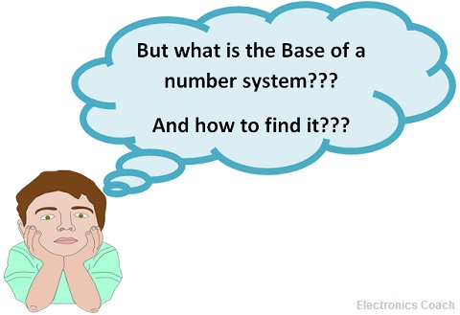
A digital system can understand positional number system only where there are a few symbols called digits and these symbols represent different values depending on the position they occupy in the number.
A value of each digit in a number can be determined using
The digit
The position of the digit in the number
The base of the number system (where base is defined as the total number of digits available in the number system).

Slide 4
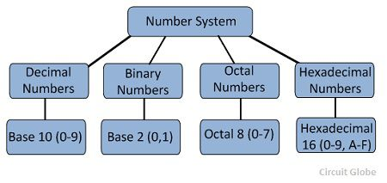
Number Systems

Slide 5
Decimal system
The number system that we use in our day-to-day life is the decimal number system. Decimal number system has base 10 as it uses 10 digits from 0 to 9. In decimal number system, the successive positions to the left of the decimal point represents units, tens, hundreds, thousands and so on.
Each position represents a specific power of the base (10). For example, the decimal number 1234 consists of the digit 4 in the units position, 3 in the tens position, 2 in the hundreds position, and 1 in the thousands position, and its value can be written as

Slide 6
(1×1000) + (2×100) + (3×10) + (4×l)
(1×10³) + (2×10²) + (3×10¹) + (4×l0⁰)
1000 + 200 + 30 + 4 1234

Slide 7
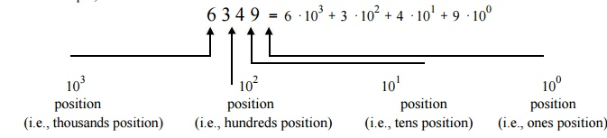

Slide 8
Binary Number System
Characteristics
Uses two digits, 0 and 1.
Also called base 2 number system
Each position in a binary number represents a 0 power of the base (2). Example: 2⁰
Last position in a binary number represents an x power of the base (2). Example: 2^{x} where x represents the last position - 1.

Slide 9
Binary system
In mathematics and digital electronics, a binary number is a number expressed in the base-2numeral system or binary numeral system, which uses only two symbols: typically 0 (zero) and 1 (one).
The base-2 numeral system is a positional notation with a radix of 2.
Each digit is referred to as a bit. I will teach about it briefly.

Slide 10
Example
Binary Number: 10101₂
Calculating Decimal Equivalent −
.
Step | Binary Number | Decimal Number
Step 1 | 10101₂ | ((1 × 2⁴) + (0 × 2³) + (1 × 2²) + (0 × 2¹) + (1 × 2⁰))₁₀
Step 2 | 10101₂ | (16 + 0 + 4 + 0 + 1)₁₀
Step 3 | 10101₂ | 21₁₀
Note: 10101₂ is normally written as 10101

Slide 11
Octal Number System
Characteristics
Uses eight digits, 0,1,2,3,4,5,6,7.
Also called base 8 number system
Each position in an octal number represents a 0 power of the base (8). Example: 8⁰
Last position in an octal number represents an x power of the base (8). Example: 8^{x} where x represents the last position - 1.

Slide 12
Example
Octal Number − 12570₈
Calculating Decimal Equivalent −
Step | Octal Number | Decimal Number
Step 1 | 12570₈ | ((1 × 8⁴) + (2 × 8³) + (5 × 8²) + (7 × 8¹) + (0 × 8⁰))₁₀
Step 2 | 12570₈ | (4096 + 1024 + 320 + 56 + 0)₁₀
Step 3 | 12570₈ | 5496₁₀
Note: 12570₈ is normally written as 12570.

Slide 13
Hexadecimal Number System
Characteristics
Uses 10 digits and 6 letters, 0,1,2,3,4,5,6,7,8,9,A,B,C,D,E,F.
Letters represents numbers starting from 10. A = 10, B = 11, C = 12, D = 13, E = 14, F = 15.
Also called base 16 number system.
Each position in a hexadecimal number represents a 0 power of the base (16). Example 16⁰.
Last position in a hexadecimal number represents an x power of the base (16). Example 16^{x} where x represents the last position - 1.

Slide 14
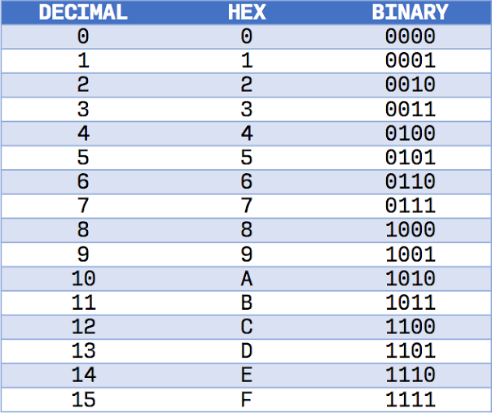

Slide 15
Example −
Hexadecimal Number: 19FDE₁₆
Calculating Decimal Equivalent −
.
Step | Hexadecimal Number | Decimal Number
Step 1 | 19FDE₁₆ | ((1 × 16⁴) + (9 × 16³) + (F × 16²) + (D × 16¹) + (E × 16⁰))₁₀
Step 2 | 19FDE₁₆ | ((1 × 16⁴) + (9 × 16³) + (15 × 16²) + (13 × 16¹) + (14 × 16⁰))₁₀
Step 3 | 19FDE₁₆ | (65536 + 36864 + 3840 + 208 + 14)₁₀
Step 4 | 19FDE₁₆ | 106462₁₀
Note − 19FDE₁₆ is normally written as 19FDE

Slide 16
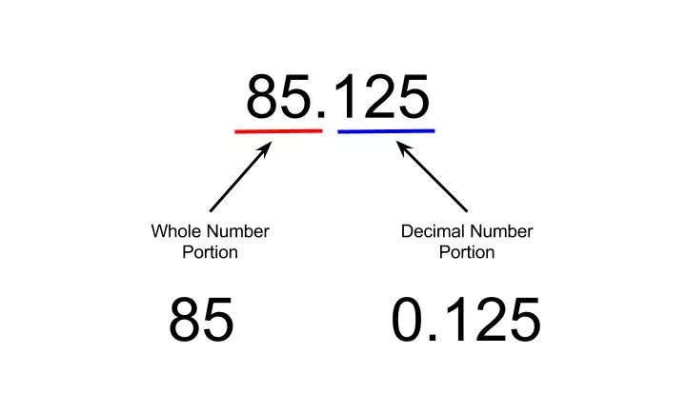
Decimal fraction
To the right of the decimal point, the digit 1 has a weight 0.1 (1/10), the digit 2 has a weight of 0.01 (1/100) and the digit 5 has a weight of 0.001(1/1000)

Slide 17
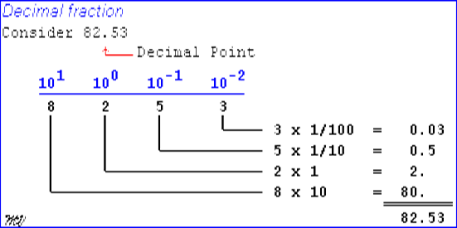

Slide 18
Binary fraction
The binary numbering system is a base-2 numbering system which contains only two digits, a “0” or a “1”. Thus each digit of a binary number can take the “0” or the “1” value with the position of the 0 or 1 indicating its value or weighting.
Similar to decimal fractions, binary numbers can also be represented as unsigned fractional numbers by placing the binary digits to the right of the decimal point or in this case, binary point. Thus all the fractional digits to the right of the binary point have respective weightings which are negative powers of two, creating a binary fraction. In other words, the powers of 2 are negative.
So for the fractional binary numbers to the right of the binary point, the weight of each digit becomes more negative giving: 2⁻¹, 2⁻², 2⁻³, 2⁻⁴, and so on as shown.

Slide 19
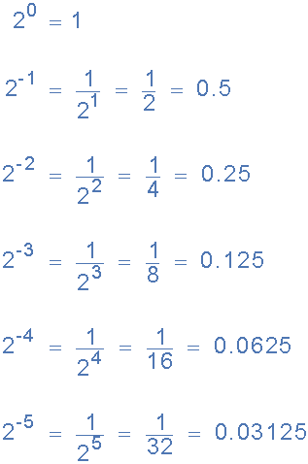
Binary fractions

Slide 20
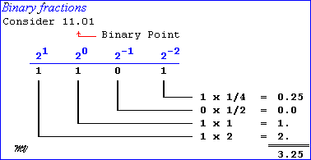

Slide 21
Now lets suppose we have the following binary number of: 1101.01112, what will be its decimal number equivalent.
1101.0111 = (1×2³) + (1×2²) + (0×2¹) + (1×2⁰) + (0×2⁻¹) + (1×2⁻²) + (1×2⁻³) + (1×2⁻⁴)
= 8 + 4 + 0 + 1 + 0 + 1/4 + 1/8 + 1/16
= 8 + 4 + 0 + 1 + 0 + 0.25 + 0.125 + 0.0625 = 13.437510

Slide 22
Decimal to binary conversion
A decimal like 19 can be converted into binary by repeatedly dividing the number by 2 and collecting the remainders (double dabble method)
2 19
2 9 – 1 LSB
2 4 – 1
2 2 – 0
2 1 -0
0 -1 MSB

Slide 23
For decimal fractions, the fractional part has to be multiplied by 2 successively and collecting the carries from top to bottom. The multiplication can be repeated till the fractional part becomes zero. If the fractional part is not zero after four or five steps the process can be stopped and we have to be satisfied with the nearest value.
For example the decimal fraction .625 is converted into binary as

Slide 24
0.625 × 2 = 1.250; carry is 1 (MSB)
0.250 × 2 = 0.500; carry is 0
0.500 × 2 = 1.000; carry is 1 (LSB)
Therefore (0.625)₁₀ = (0.101)₂

Slide 25
PROBLEMS- decimal to binary
Convert (107.6875)
Convert (52.4)
2 107
2 53 -1
2 26 -1
2 13 -0
2 6 -1
2 3 -0
2 1 -1
0 -1

Slide 26
0.6875 = 0.1011₂
52.4 = 110100.0110₂

Slide 27
Hexadecimal to decimal
Convert D5_{H} to decimal
(D5)_{H} = (13×16¹ + 5×16⁰)
= (13 ×16 + 5× 1)
= (208+5)
= 213₁₀

Slide 28
(E9)_{H} = (233)_{H}
(3FC.8)_{H} = (1020.5)_{H}
(FFFF)_{H} = (65535)_{H}

Slide 29
Decimal to hexadecimal
Convert 213 to Hex
16 213
13 -5
0 -13 (D)
(213)₁₀ = D5_{H}

Slide 30
Hexadecimal to binary
Convert (25)_{H} to Binary
25_{H} = (0010 0101)₂
Convert (3A.7) to Binary
(3A.7)_{H} = (0011 1010. 0111)₂
Convert (CD.E8) to Binary
(CD.E8) = (1100 1101. 1110 1000)₂

Slide 31
BINARY TO DECIMAL
(1010.1101)₂ = (A.D)_{H}
(110.101) = (0110.1010) = (6.A)_{H}
(1110.11)₂ = (1110.1100) = (E.C)_{H}

Slide 32
OCTAL TO DECIMAL
Decimal | Octal | Binary
0 | 0 | 000
1 | 1 | 001
2 | 2 | 010
3 | 3 | 011
4 | 4 | 100
5 | 5 | 101
6 | 6 | 110
7 | 7 | 111

Slide 33
Octal to decimal
Convert (75)₈ to decimal
(75)₈ = (7×8¹ + 5×8⁰)
= (7×8 + 5× 1)
= (56+5)
= 61₁₀

Slide 34
Decimal to octal
Convert 68₁₀ to octal
8 68
8 8 - 4
8 1 – 0
0 – 1
(68)₁₀ = (104)₈

Slide 35
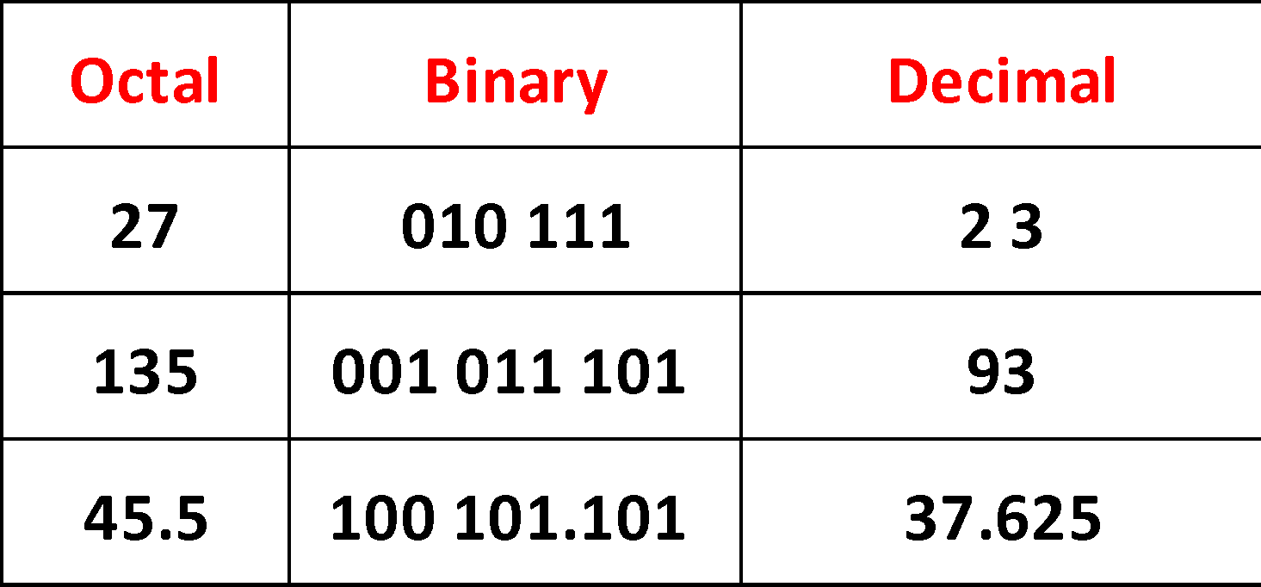
Octal to binary

Slide 36
Binary to octal
(10 101)₂ = (010 101)₂ = (25)₈
(10111.1) = (010 111 . 100) = (2 7 . 4)₈

Slide 37
Binary to decimal
(11101)
(111.11)
Hex to decimal
(50)_{H}
(3EF)_{H}
Decimal to Hex
(48)₁₀
(1024)₁₀
_{Hex} to binary (99)_{H} , (FF.E6)_{H}

